Slide 1
Pathways Analysis: databases and methods for genetics.
Dr. Gerome Breen
UPDATED BY: HELENA A. GAspar

Slide 2
Outline
1. What are pathways?
2. Pathway Resources
3. Pathways Analysis and GWAS
4. PGC CDG GWAS Pathway Analysis
5. Drug/GWAS Pathway Analysis

Slide 3
1. What are pathways?
A series of actions among molecules leading to a product or a change.
Molecule 1
Molecule 2
Interaction 1
Molecule 3
Interaction 2
Product

Slide 4
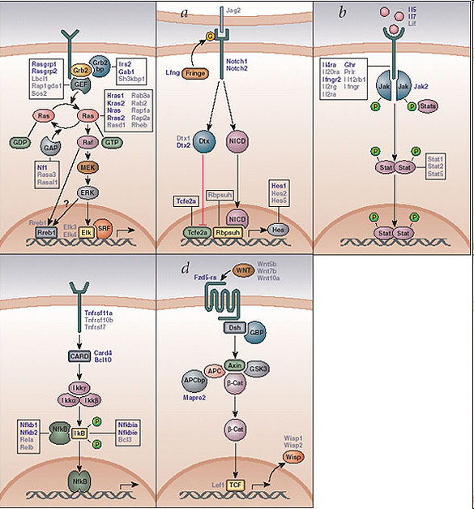
A typical pathway: WNT Signalling
A typical pathway: WNT Signalling
Wnt ligand binds to
to a Fz receptor
(…)
Unphosphorylated β-catenin translates into the nucleus
Regulation of target genes
Image from Suzuki et al 2002 Nature Genetics 32 166

Slide 5
Pathways v.s. Networks
Pathway: series of actions among molecules leading to a product or a change.
Network: a collection of nodes (molecules) and edges (type of interaction).

Slide 6
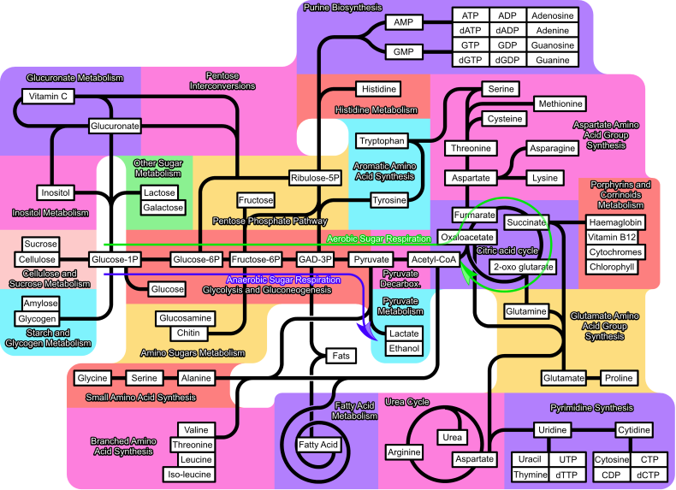
Pathways v.s. Networks
In biology, everything is interconnected in a network. But pathways provide intuitive views.

Slide 7
Pathways v.s. Networks
Early pathways were built by studying biochemical reactions of individual proteins, measuring the activity, learning the substrates and products, joining them to the next enzyme.
New technologies allow simultaneous measurement of tens of thousands of different molecules.
This reveals that many biological pathways are interconnected. They can work together or against each other.
Scientists who study these large scale interactions sometimes refer to the field as ‘systems biology’.
When multiple biological pathways interact = a biological network.
Biologists often work with canonical pathways, those that represent the well-understood part of the entire network.

Slide 8
Different types of pathways
Metabolic pathways:
provide the energy and materials
Signalling pathways:
sense the outside, coordinate activities within and between cells
Gene regulatory pathways:
control processes, set limits, control the molecular composition of cells

Slide 9
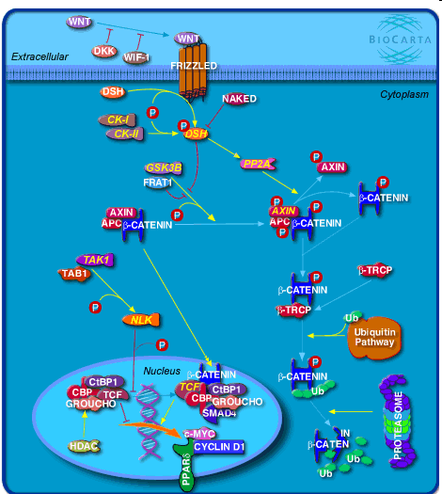
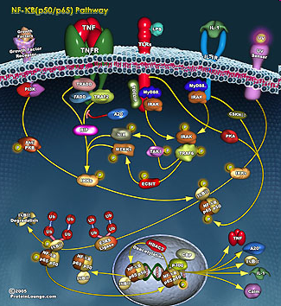
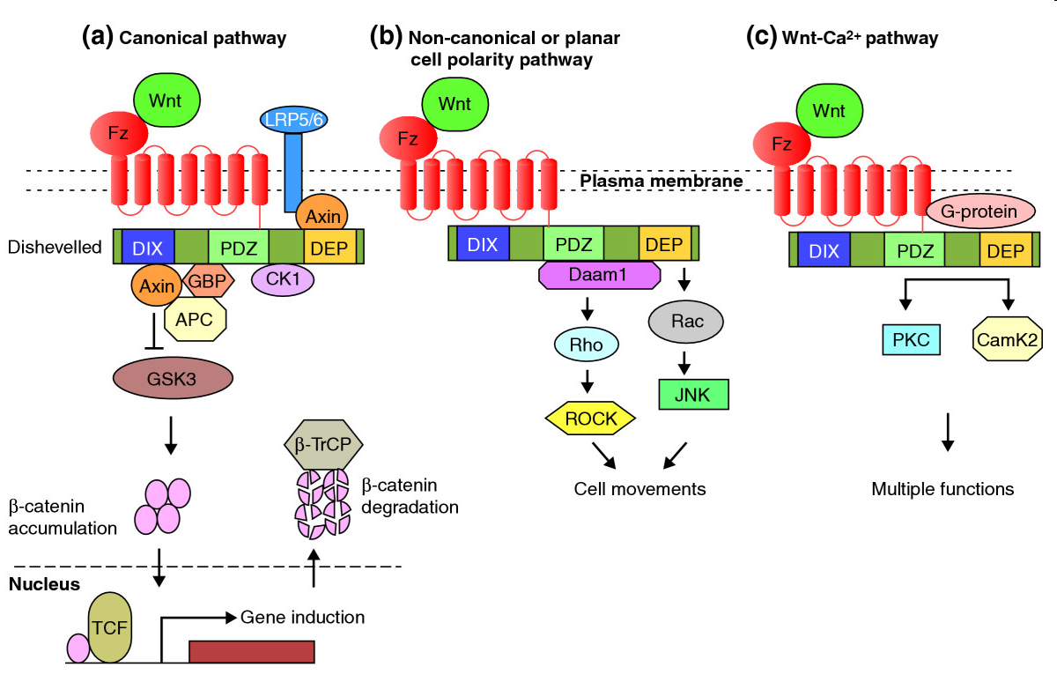
Different representations for one pathway
Image from Suzuki et al 2002 Nature Genetics 32 166, Habas & Dawid 2005 J Biol 4:2, BioCarta, SigmaAldrich Pathfinder
Notes:
But there are lots of WNT signalling pathways out there.
Often hand curated
Often relating to specific experiments, diseases or time points.
Making these tools available for computational methods of analysis will allow researchers to connect pathways to databases of biological annotations and experimental data, creating effective products of systems biology.
Collecting and maintaining pathway information in a robust database, however, is an ongoing challenge

Slide 10
2. Pathway resources: private companies
e.g. Ingenuity Pathway Analysis & GeneGO
Manually curated
Subset of literature covered
Pre-generated networks
Make own networks

Slide 11
Pathway resources: free databases
Metabolic pathways:
Reactome, GO, KEGG, Pathway Commons (…)
Signalling pathways:
Reactome, GO, Panther (…)
Gene regulatory networks:
ConsensusPath-DB, GeneMania (…)
Diagrams:
WikiPathways, KEGG, BioCarta, (...)
Other databases for protein-protein interactions, protein-compound interactions…

Slide 12
Pathway resources: free databases
Main resources:
REACTOME
Gene Ontology (GO)

Slide 13
Reactome
Free, online & open-source
Curated resource of core pathways and reactions in human biology
Authored by expert biological researchers
Maintained by the Reactome editorial staff
Cross-referenced to
NCBI Entrez Gene, Ensembl and UniProt databases
UCSC and HapMap Genome Browsers
KEGG Compound and ChEBI small molecule databases
PubMed, and GO
Human data used to infer orthologous events in 22 non-human species
Tools for data analysis include Skypainter and Biomart

Slide 14
Encoding Journal Information
Nature 407(6805):770-6.The Biochemistry of Apoptosis.
“Caspase-8 is the key initiator caspase in the death-receptor pathway. Upon ligand binding, death receptors such as CD95 (Apo-1/Fas) aggregate and form membrane-bound signalling complexes (Box 3). These complexes then recruit, through adapter proteins, several molecules of procaspase-8, resulting in a high local concentration of zymogen. The induced proximity model posits that under these crowded conditions, the low intrinsic protease activity of procaspase-8 (ref. 20) is sufficient to allow the various proenzyme molecules to mutually cleave and activate each other (Box 2). A similar mechanism of action has been proposed to mediate the activation of several other caspases, including caspase-2 and the nematode caspase CED-3 (ref. 21).”
How can I access the pathway described here and reuse it?
Reactome

Slide 15
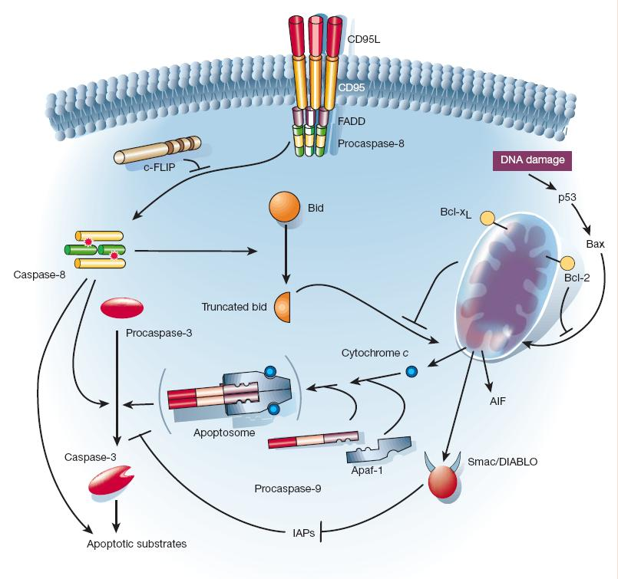
Encoding Figures
A picture:
Just pixels!
Omits key details
Facts or hypothesis?
Reactome

Slide 16

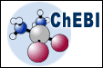


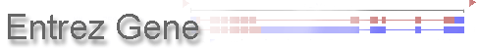
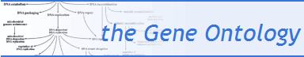
Reactome is like many other databases…
Extensively cross-referenced
Tools for data analysis – Pathway Analysis, Expression Overlay, Species Comparison, Biomart…
Used to infer orthologous events in 20 other species.

Slide 17
Data Expansion – Projecting to Other Species
Human
B
A
+ ATP
A
-P
+ ADP
Mouse
B
A
+ ATP
A
-P
+ ADP
Drosophila
A
B
+ ATP
Reaction not
inferred
No orthologue - Protein not inferred

Slide 18

Reactome: Theory - Reactions
BINDING
DEGRADATION
DISSOCIATION
DEPHOSPHORYLATION
PHOSPHORYLATION
CLASSIC
BIOCHEMICAL
TRANSPORT

Slide 19
Reactome: Exportable Protein-Protein Interactions (PPIs)
Inferred from complexes and reactions
Interactions between proteins in the same complex, reaction, or adjoining reaction
Lists available from Downloads

Slide 20
Gene Ontology Consortium
http://geneontology.org/
Largest and best known (at least in the USA).
Reactome and GO probably the two best.

Slide 21

3. Pathway Analysis
Your favorite gene set

Slide 22
Pathway Analysis
Your favorite gene set
20 genes, 9 positive.
Is that finding significant?

Slide 23
Pathway Analysis
Your favourite gene set
All your genes
Significant genes
Contingency Table
11 9
P = 1x 10⁻⁹
1950 50

Slide 24
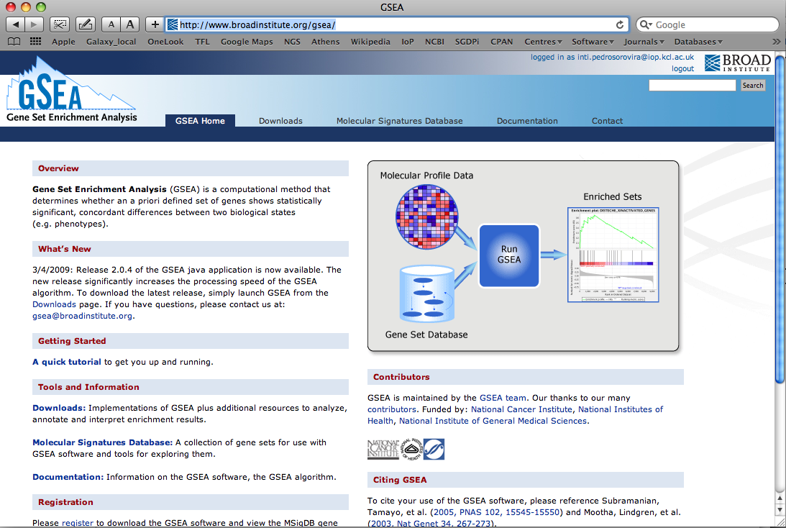
Gene Set Enrichment Analysis
http://www.broadinstitute.org/gsea/

Slide 25
GWAS Pathway Analysis
Classical GWAS studies focus on the analysis of single genetic variants:
Is a genetic variant associated to a trait of interest?
The more powerful pathway-based approaches also use information on known biological pathways
Are some genes in the same pathway associated to the trait of interest?

Slide 26
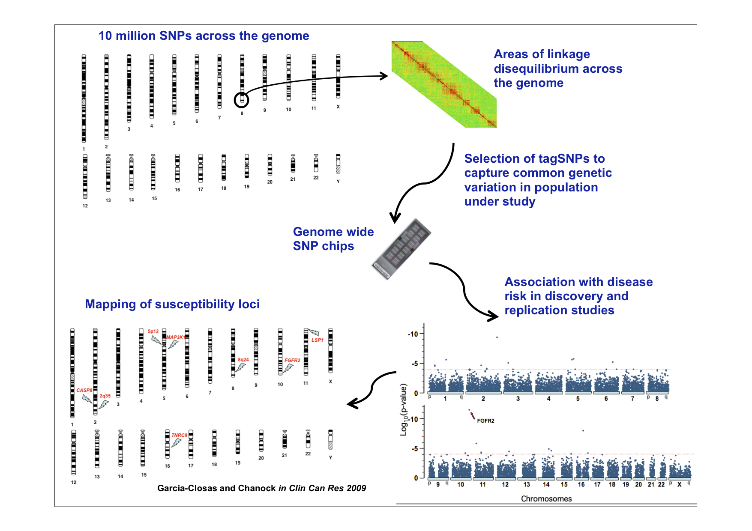
Genome-Wide Association Studies (GWAS)

Slide 27
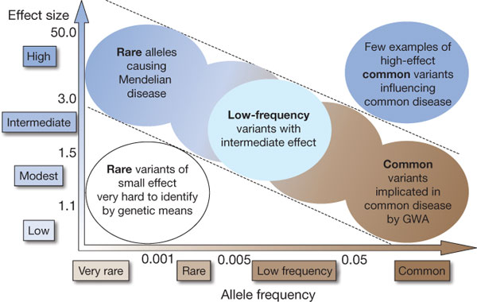

Genome-Wide Association Studies (GWAS)

Slide 28
The design of GWAS is based on information capture via LD tagging
Linkage desequilibrium (LD) = nonrandom association of alleles at different loci
X
LD
X
LD
X
No LD
X
1 2
Two independent signals
Several genes can be mapped to one association
LD
X
X
X
X
X
X
X
X
promoter
SNPs for gene A
coding
SNPs for gene B
SNPs in gene C
SNPs In
Distant genes

Slide 29
The design of GWAS is based on information capture via LD tagging
Although only Single Nucleotide Polymorphisms (SNP) are assayed, much information about common
Variable Number Tandem Repeats (VNTR)
Copy Number Polymorphisms (CNPs)
Insertion/Deletions (Indel)
Inversions
is captured by GWAS arrays.

Slide 30
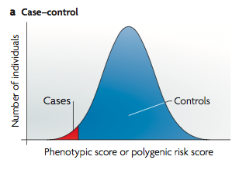
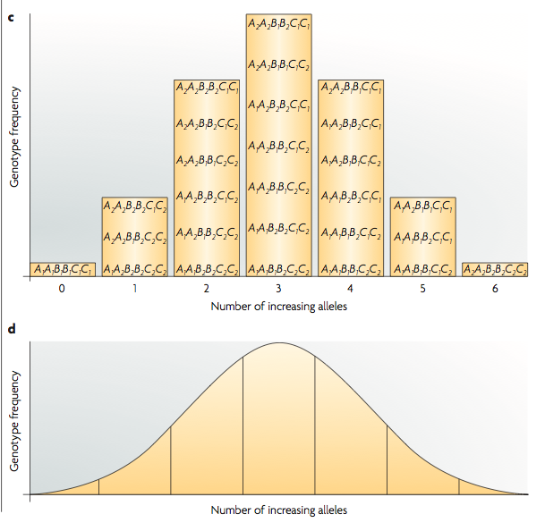
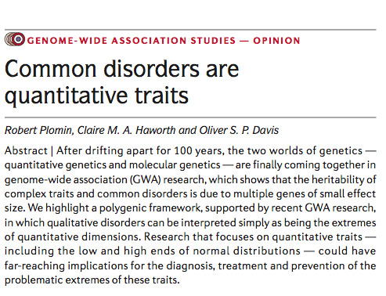
GWAS research suggests that complex diseases are affected by many variants with small effects

Slide 31
Genes in GWAS Data show evidence of multiple signals and high correlation between SNPs
-log10 p-value
20 kb
20 kb

Slide 32
GWAS pathway analysis: two main routes
Gene-wise
Derive a gene-wide statistic.
Then assess gene sets using many possible methods:
Correct min p-value (e.g. Sidak)
Threshold
Combine p-values (e.g. Fisher’s method)
Direct gene-set analyses
Treat a pathway as one large gene.

Slide 33
GWAS Pathway Analysis Software
MAGMA
INRICH
ALIGATOR
FORGE
MAGENTA
…

Slide 34
Using a method designed for gene expression data on genetic variation (GWAS data). Axon Guidance comes up strongly.
WTCCC Bipolar Disorder
Best p-value per gene
Pathway | Nominal P | FDR
GO0007411 | < 1e-3 | 0.003 | Axon growth cone guidance
hsa04510 | < 1e-3 | 0.005 | Focal adhesion
hsa00040 | < 1e-3 | 0.006 | Pentose and glucuronate interconversions
GO0019198 | < 1e-3 | 0.006 | The catalysis of phosphate removal from a phosphotyrosine using aspartic acid as a nucleophile in a metal-dependent manner
GO0003779 | < 1e-3 | 0.028 | Membrane associated actin binding
hsa04512 | < 1e-3 | 0.031 | ECM-receptor interaction
Sklar et al.
Pathway | Nominal P | FDR
GO0007411 | < 1e-3 | 0.025 | Axon growth cone guidance

Slide 35
Axon Guidance significant across all human disorders and diseases!
 | T1D | T2D | RA | HT | CAD | CD | BP
GO0007411 | 0.004 | 0 | 0.004 | 0.001 | 0 | 0.002 | 0
hsa04510 | 0.081 | 0.037 | 0.143 | 0.001 | 0.021 | 0.003 | 0.095
The results were being driven by pathways having very large average gene sizes.
Lesson: Always use software written for GWAS pathway analysis.
Reliable methods correct for LD, gene size, and other issues.

Slide 36
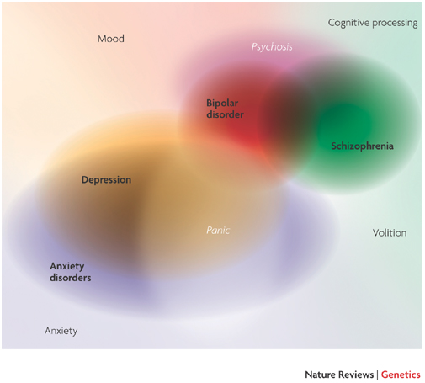
4. PGC CDG GWAS Pathway Analysis
5 methods
5 diseases
Schizophrenia
Manic Depression
Major Depression
Autism
ADHD

Slide 37
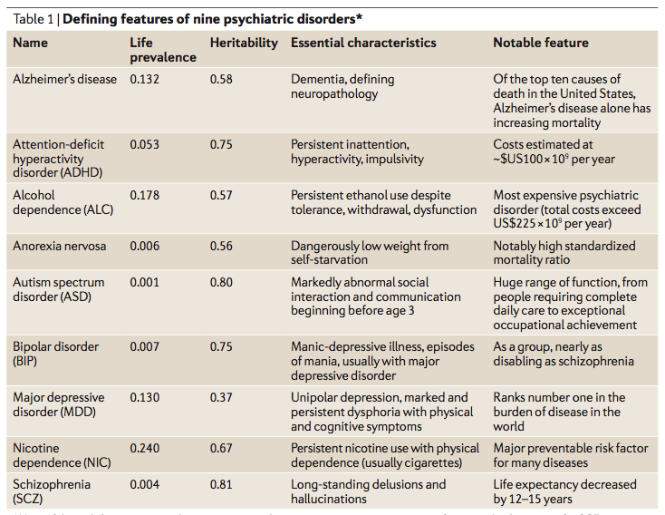
Psychiatric Disorders

Slide 38
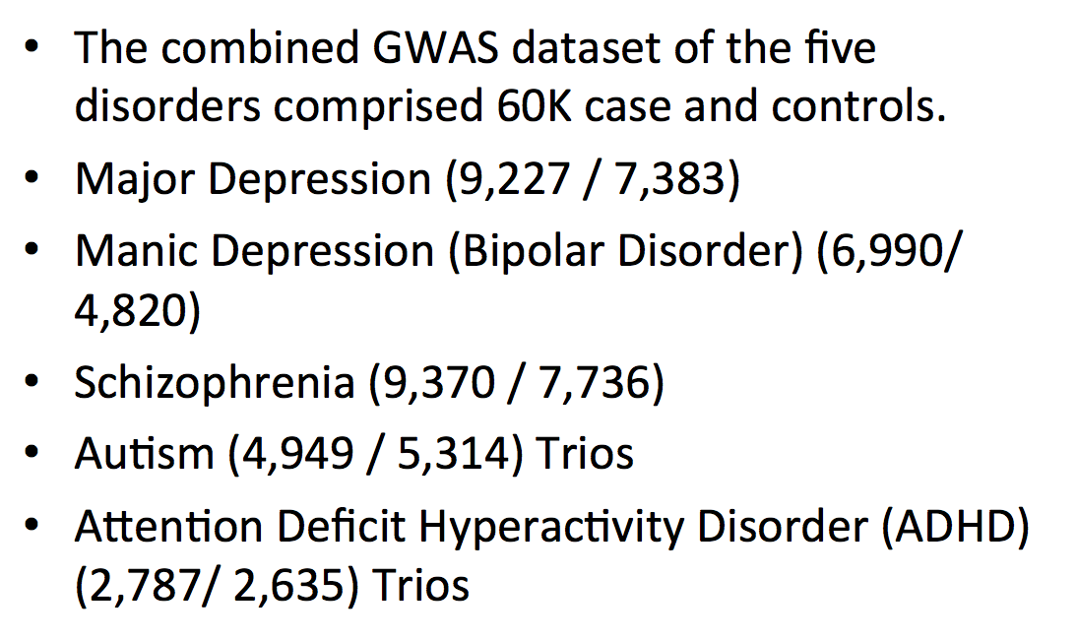
Samples

Slide 39
Pathway Analysis Methods
Thresholded best/number in gene/region methods
ALIGATOR
INRICH
MAGENTA
Gene-wide/Pathway-wide methods
Set-screen test
FORGE

Slide 40
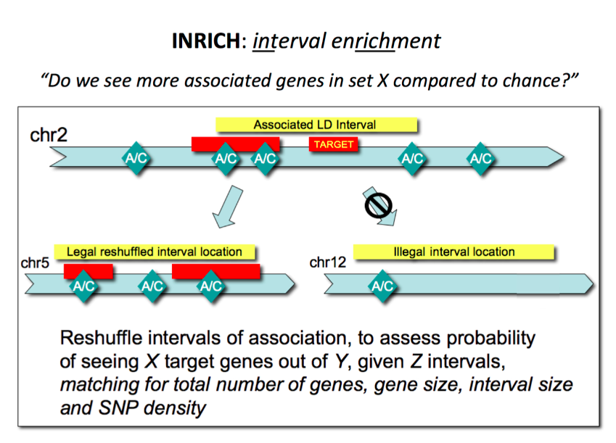
INRICH

Slide 41

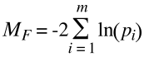
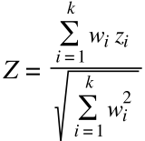
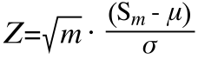
FORGE: gene p-values by LD corrected meta-analysis and GSA Pedroso….Breen et al., Biol Psych 2012
-log10 p-value
20 kb
20 kb
Meta-analysis
Stephen Newhouse
Gene-set
Analyses

Slide 42

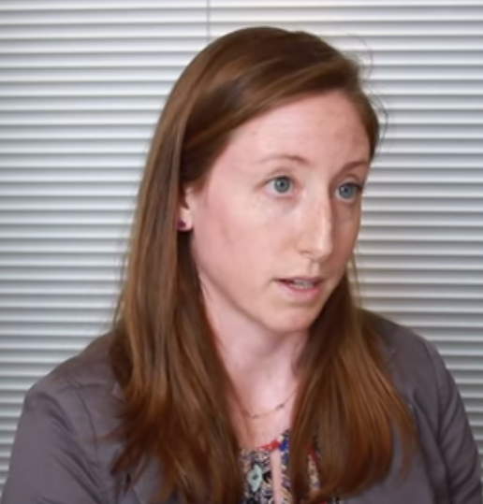
Databases – lots of them and lots of work
Database | # Genes covered | # Pathways | Median Pathway Size (min-max)
KEGG | 5952 | 232 | 52 (1-1131)
GO | 8589 | 7112 | 2 (1-2407)
Reactome | 4539 5077 | 3526 (Reaction) 1086 (Pathway) | 3 (1-434) 14 (1-934)
PANTHER | 2170 | 140 | 16 (1-287)
OMIM | 6983 | 4712 | 2 (1-22)
TargetScan | 11095 | 162 | 173 (1-1240)
Colm O`Dushlaine
Lizzy Rossin

Slide 43
Comparing methods and disorders
Each method has its advantages…
Comparing Disorders:
BIPOLAR, MDD, SCZ
Autism and ADD (PGC1 versions) are less well powered, making comparisons difficult

Slide 44

PGC Disorders
Phil Lee
SCZ, BIPOLAR and MDD are well-powered
Overlap in the top 10% of pathways? (INRICH)
1153
165
153
19
1151
155
1163
OBSERVED
EXPECTED
Notes:
INRICH

Slide 45
Derive a combined p-value for three psychiatric disorders

Slide 46
Top Pathways
Results from a combined analysis of 5 methods on the 5 PGC1 CDG datasets but we focused on the three adult disorders.
Thus, the results reflect the average across the 5 methods used.
Significant q-values (= FDR adjusted p-values) defined as < 0.05 and suggestive < 0.5.
MHC region excluded (high-LD genes also in that region on chromosome 6).

Slide 47
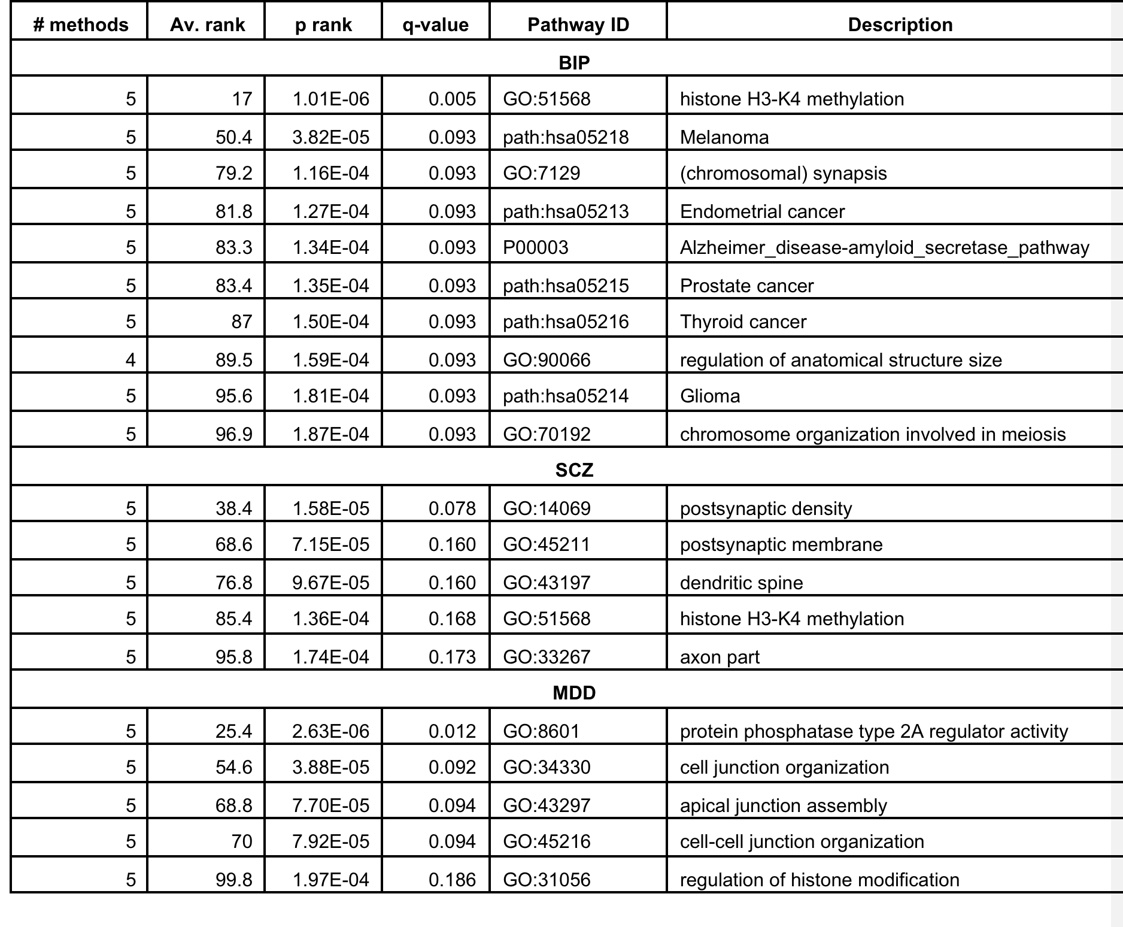
Pathway results SCZ, BIP, MDD

Slide 48
What are key differences in meta-analysis of pathway results?
Each disorder gave promising but not statistically compelling evidence for pathway association.
Analyse each disorder’s pathways and then combine and meta-analyse.
May be much more powerful than SNP meta analysis.
Robust to
Allelic heterogeneity within GENES and within PATHWAYS across diseases.
Allows for a multitude of weaker effects.
Modulation of the pathways can differ across disorders.

Slide 49
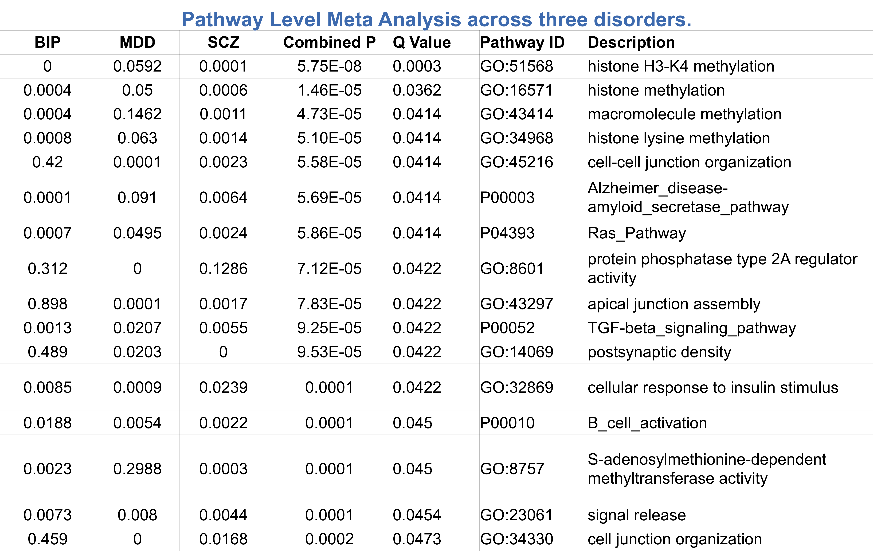
Meta-analysis of the pathway results SCZ, BIP, MDD 16 pathways with FDR < 0.05, 49 with FDR < 0.1

Slide 50
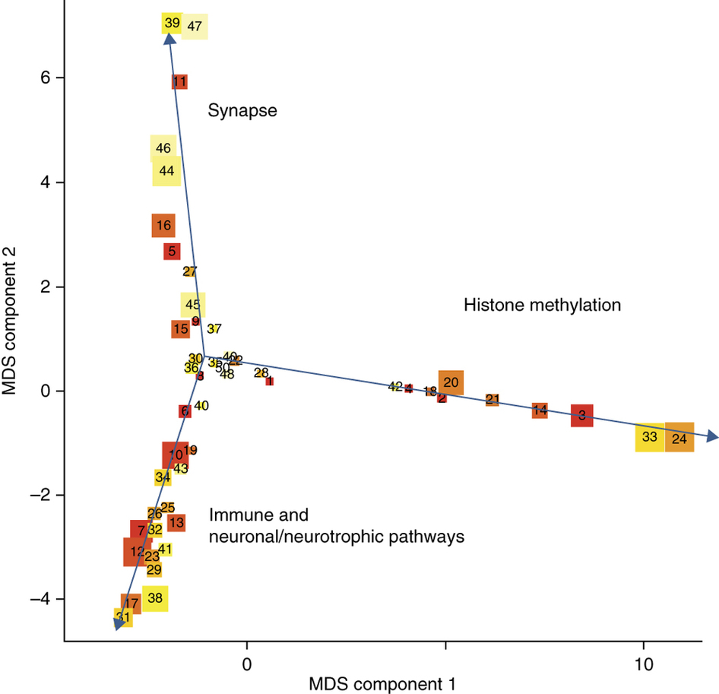
Multidimensional scaling plot of top 50 pathways with suggestive significance (FDR < 0.5)

Slide 51
5- Drug/GWAS Pathway Analysis
Using GWAS summary statistics, drug/gene information and pathway analysis tools to:
Find new purposes for known drugs
Find new potential leads for specific disorders

Slide 52
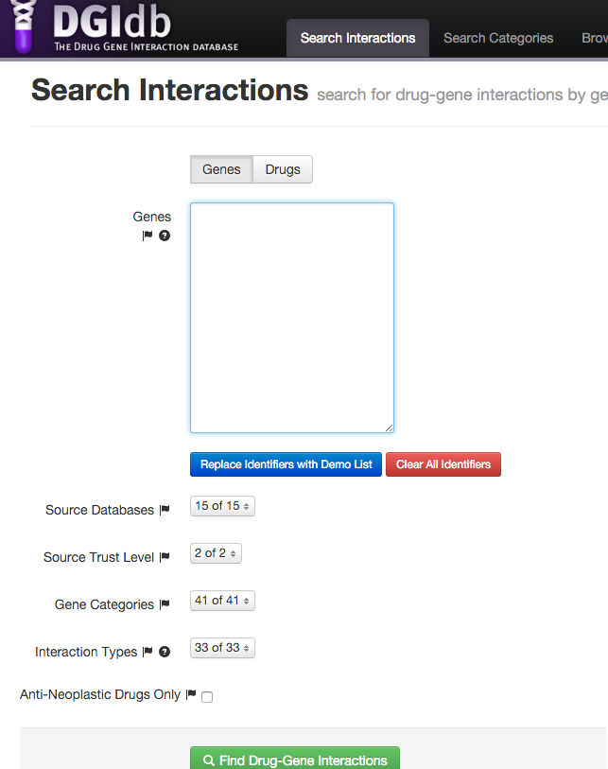
Mine Drug/Gene Interactions: DGIdb
http://dgidb.genome.wustl.edu/
Paste gene or drug list here
The whole database can be downloaded.

Slide 53
Mine Drug/Gene Interactions: DGIdb
Drug-gene interactions mined from 15 databases:
DrugBank
therapeutic target database (TTD)
PharmGKB
Targeted agents in lung cancer (TALC)
TdgClinicalTrial
ChEMBL
CancerCommons
MyCancerGenome, MyCancerGenomeClinicalTrial
CIViC
ClearityFoundationBiomarkers
ClearityFoundationClinicalTrail
DoCM
GuideToPharmacologyInteractions
Trends in the Exploration of Novel Drug targets

Slide 54
GWAS Summary Statistics
AMD, Age-related macular degeneration
CARDIoGRAM, Coronary Artery Disease
CHIC, Childhood intelligence
DIAGRAM, Diabetes
EGG, Early growth
ENIGMA, Brain volume
GCAN, Anorexia Nervosa
GEFOS, Osteoporosis
GIANT, Anthropometric traits
MAGIC,Glycaemic traits
GLGC, Lipids
PGC, Psychiatric disorders
ReproGen, Reproductive ageing
SSGAC, Social science outcomes
TAG, Tobacco
IMSGC, Multiple sclerosis
GPC, Personality traits

Slide 55
Drug/GWAS Pathway Analysis
Trait 1 Trait 2
Drug 1 p-value p-value
Drug 2 p-value p-value
PATHWAY ANALYSIS
Gather GWAS summary statistics for variants
Gather drug/gene information
Assign p-value to gene (MAGMA)
Gene 1 Gene 2 Gene 3
Drug 1 YES NO YES
Drug 2 YES NO NO
Gene 1 Gene 2 Gene 3
Trait 1 p-value p-value p-value
Triat 2 p-value p-value p-value

Slide 56
Some key references
http://www.ncbi.nlm.nih.gov/pubmed/25599223
http://www.ncbi.nlm.nih.gov/pmc/articles/PMC3378813/

